Slide 1


MEASURING
OUTCOME

Slide 2

FACILITATE THE GAM
E
This game is based on Evidence Based Management (EBM). EBM is an empirical framework organizations can use to help measure the (perceived) product value, and the way they deliver their product(s). The measurements can be inspected to help maximize product value and improve the way of working.
Scrum Facilitators is a Dutch-based training organization on a mission to help professionals become awesome Scrum facilitators. A Scrum Facilitator can be a Scrum Master, Product Owner, developer or leader. Great Scrum Facilitators understand the Scrum values & principles and use these to effectively implement Scrum with their teams and organizations.
Scrum Facilitators is a Scrum.org partner. Our classes are accredited, always up-to-date, fun, super interactive and always facilitated by two trainers to maximize your learning objectives. Our trainers are seasoned experts and Scrum.org certified Professional Scrum Trainers with substantial real life experience in various settings.
As a Scrum Facilitator, put the four Key Value Areas (KVAs) in a row on the floor (Current Value, Time to Market, Ability to Innovate and Unrealized Value). Explain each KVA to the participants.
Form two groups and hand one group the green Key Value Measures cards (KVMs) and the other group the remaining purple KVMs.
Step 1: Invite the group(s) to discuss and put the KVMs under the correct KVA.
Step 2: Invite both groups to discuss their results and adapt their cards. Make sure by the end of this round, the KVM cards are under the correct KVA.
Step 3: Invite the participants to individually look at the KVMs and select one KVM that caught their attention. (A non-EBM KVM may also be chosen at this point)
Step 4: Invite the participants into groups of four. Ask each participant to explain why they chose their particular KVM and collaborate on how to implement it. (In case of non-EBM measures, pay attention that these are not vanity metrics and discuss the potential pitfalls)
Learn about Evidence-Based Management (EBM) at http://scrum.org/EBM
The Measuring Outcome game (v1.0.2) is licensed under
CC BY-NC-SA 4.0
By Scrum Facilitators

Slide 3
Reveals the value that the product delivers to customers, today
CURRENT VALUE
Reveals the value that the product delivers to customers, today

Slide 5

TIME TO MARKET
Expresses the organization’s ability to quickly deliver new capabilities, services, or products

Slide 7
ABILITY TO
INNOVATE
Expresses the ability of a product development organization to
deliver new capabilities that might better meet customer needs

Slide 9
UNREALIZED VALUE
Suggests the potential future value that could be realized
if the organization could perfectly meet the needs of all potential customers

Slide 11
Customer
Satisfaction

Slide 13
Feature
Usage Index

Slide 15
Defect Trends

Slide 17
Product
Cost Ratio

Slide 19
Installed
Version Index

Slide 21
Build & Integration Frequency

Slide 23
Production Incident Trends

Slide 25
Release
Stabilization
Period

Slide 27
Market
Share

Slide 29
Cycle Time

Slide 31
Time-to-Learn

Slide 33
Employee Satisfaction

Slide 35
Customer
Usage Index

Slide 37
Revenue
per Employee

Slide 39
Release
Frequency

Slide 41
Mean Time
to Repair

Slide 43
Lead Time

Slide 45
Innovation
Rate

Slide 47
On-Product
Index

Slide 49
Technical
Debt

Slide 51
Active Code Branches / Time Spent Merging Branched Code

Slide 53
Time Spent
Context-Switching

Slide 55
Customer or User Satisfaction Gap

Slide 57
Don’t measure Output. Measure Outcomes

Slide 59
It’s not about the Metrics, but about the Conversation

Slide 61
Learn more about
Evidence Based Management at
http://scrum.org/EBM

Slide 63
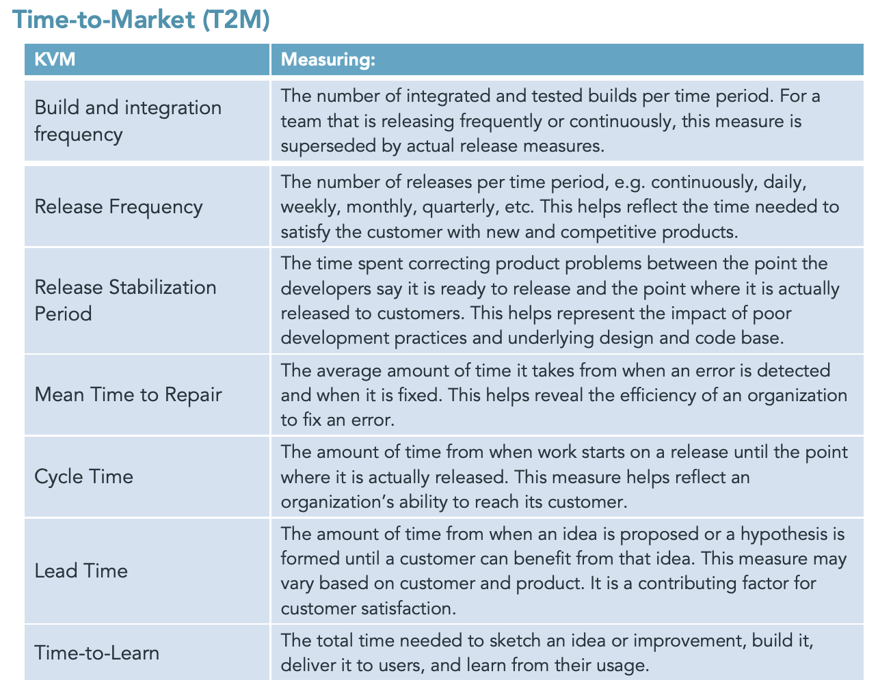
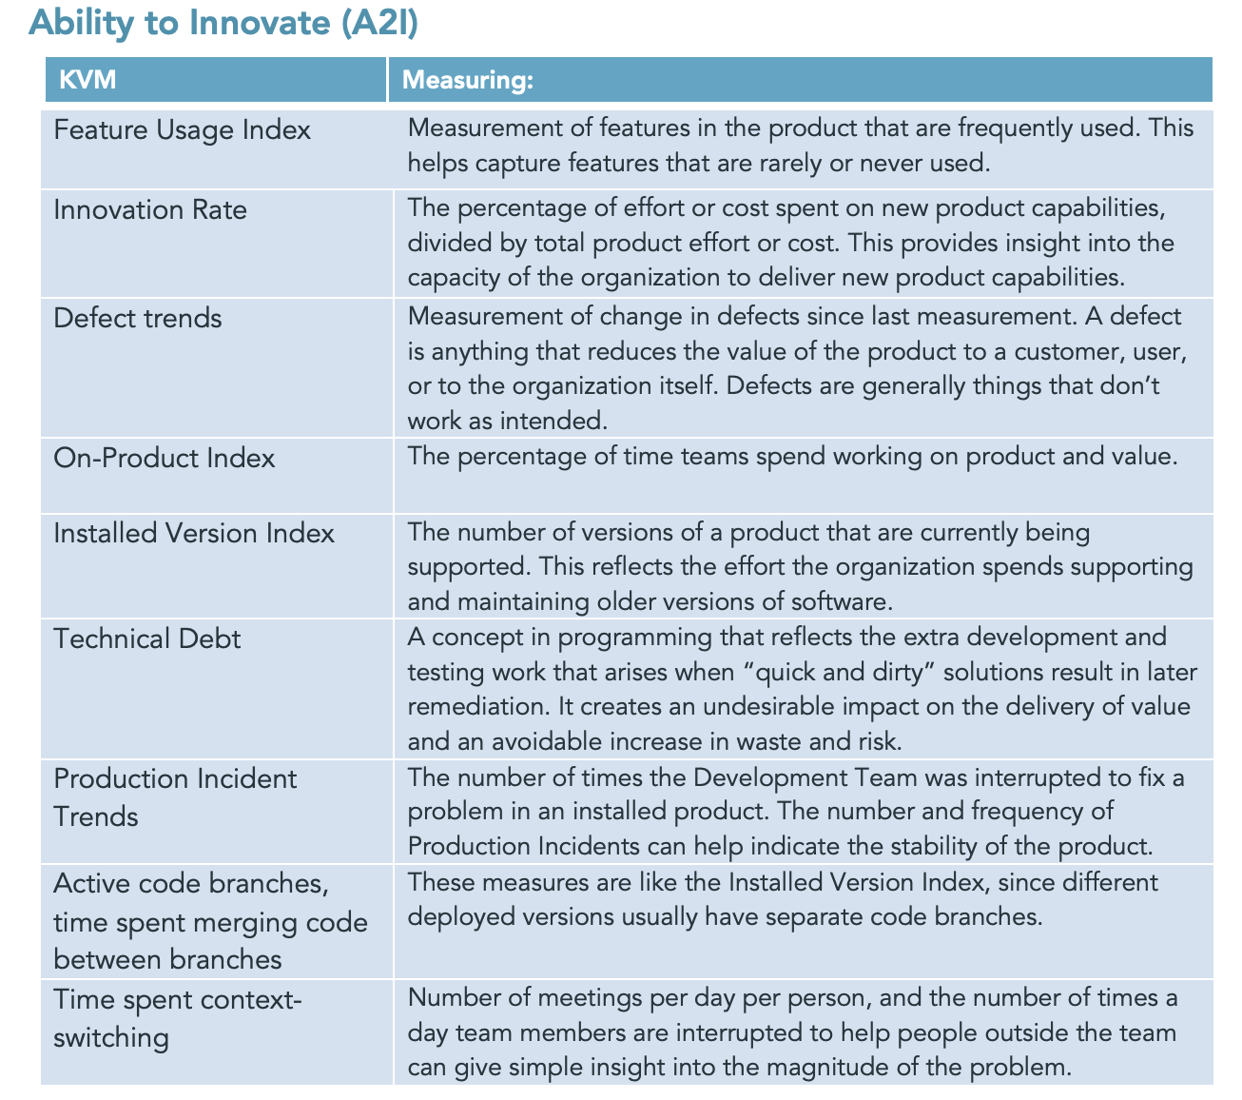
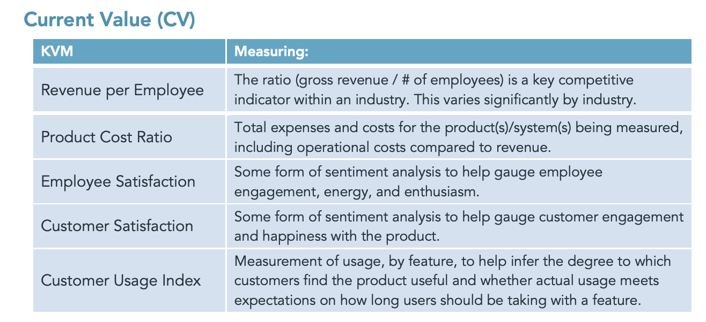
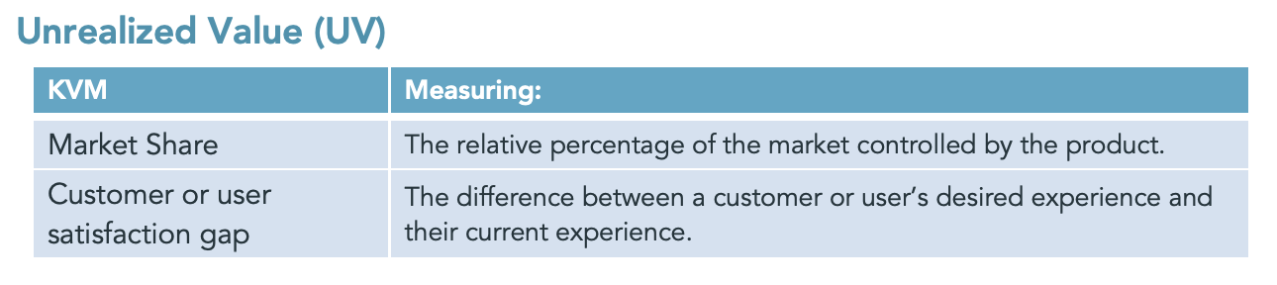
EBM suggested cheat sheet
Source: EBM guide, http://scrum.org/EBM

